Slide 1

Sleep Health and Lifestyle Dataset
Presented by :
G.SAI HASINI
2203A52086
TO:
Ramesh Dadi
faculty of STATML

Slide 2

INTRODUCTION:
Unlock sleep insights with the Sleep Health Dataset.The Sleep Health and Lifestyle Dataset comprises 400 rows and 13 columns, covering a wide range of variables related to sleep and daily habits. It includes details such as gender, age, occupation, sleep duration, quality of sleep, physical activity level, stress levels, BMI category, blood pressure, heart rate, daily steps, and the presence or absence of sleep disorders
Problem statement: Sleep plays a crucial role in overall health and well-being. Poor sleep patterns and lifestyle choices can lead to a variety of health issues, including obesity, cardiovascular diseases, and mental health disorders. To address these concerns, we aim to develop a predictive model that classifies individuals into different sleep pattern categories based on their lifestyle choices and habits.

Slide 3
Dataset Columns: Person ID: An identifier for each individual. Gender: The gender of the person (Male/Female). Age: The age of the person in years. Occupation: The occupation or profession of the person. Sleep Duration (hours): The number of hours the person sleeps per day. Quality of Sleep (scale: 1-10): A subjective rating of the quality of sleep, ranging from 1 to 10. Physical Activity Level (minutes/day): The number of minutes the person engages in physical activity daily. Stress Level (scale: 1-10): A subjective rating of the stress level experienced by the person, ranging from 1 to 10. BMI Category: The BMI category of the person (e.g., Underweight, Normal, Overweight). Blood Pressure (systolic/diastolic): The blood pressure measurement of the person, indicated as systolic pressure over diastolic pressure. Heart Rate (bpm): The resting heart rate of the person in beats per minute. Daily Steps: The number of steps the person takes per day. Sleep Disorder: The presence or absence of a sleep disorder in the person (None, Insomnia, Sleep Apnea).

Slide 4
Key Features of the Dataset:
Comprehensive Sleep Metrics: Explore sleep duration, quality, and factors influencing sleep patterns. Lifestyle Factors: Analyze physical activity levels, stress levels, and BMI categories. Cardiovascular Health: Examine blood pressure and heart rate measurements. Sleep Disorder Analysis: Identify the occurrence of sleep disorders such as Insomnia and Sleep Apnea.

Slide 5
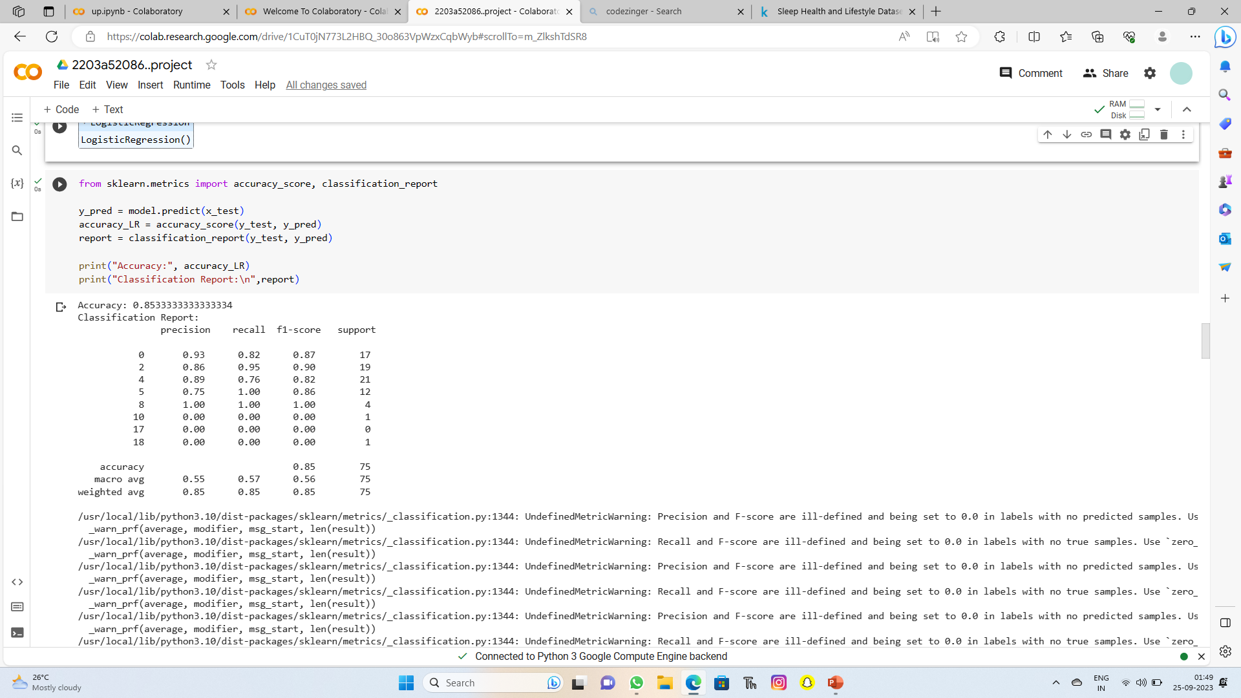
SCREEN SHORT:

Slide 6
IMPLEMENTATION
Supervised Learning
Parametric Approach
Classification
Logistical Regression
Perceptron Learning
SVM classifier
K-NearestNeighbors(KNN)
Bootstrapped Logistic Regression
Bootstrapped svm

Slide 7
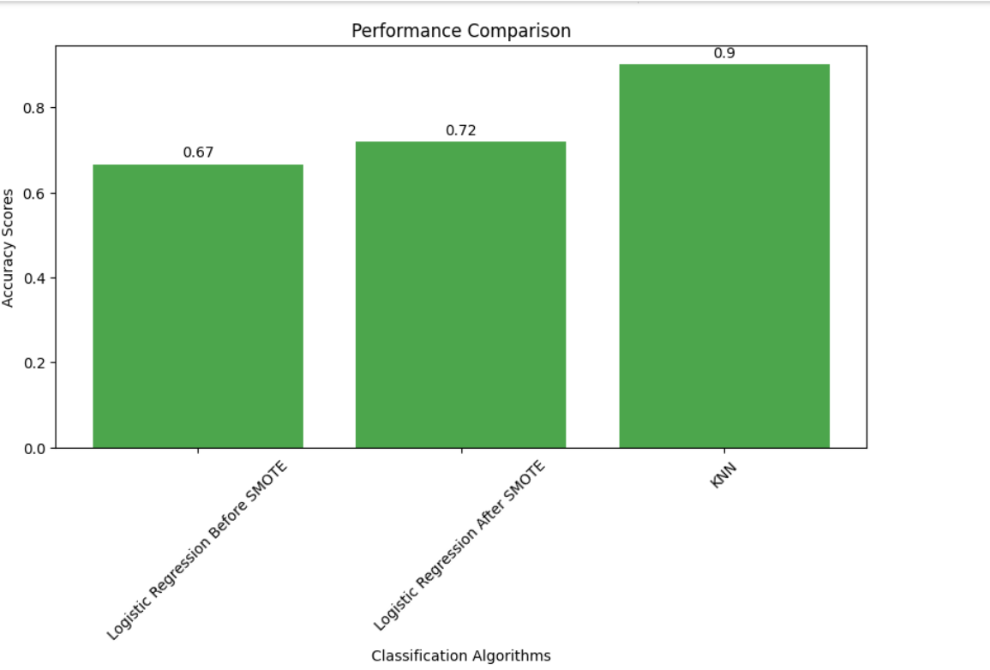
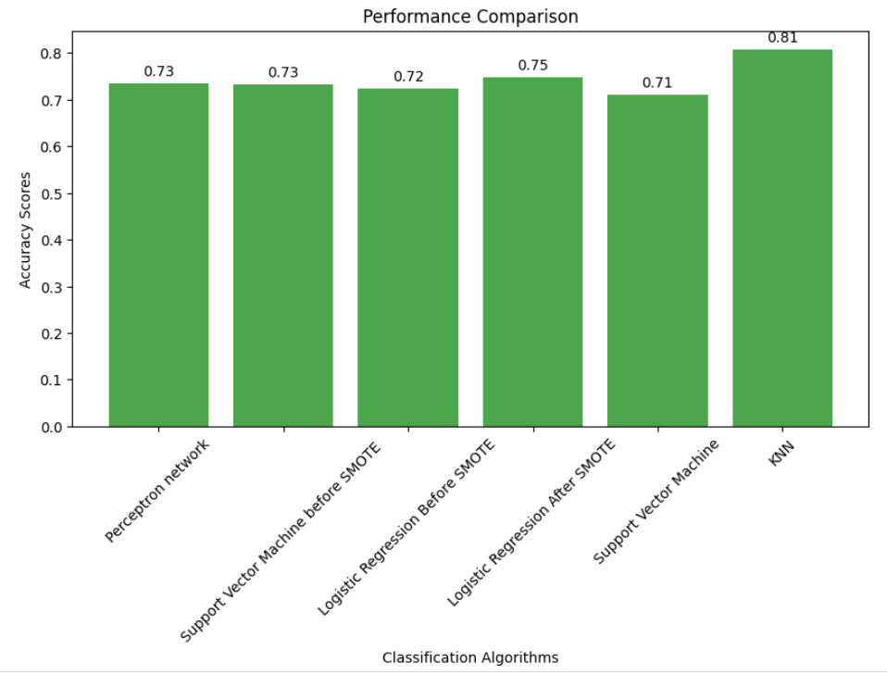
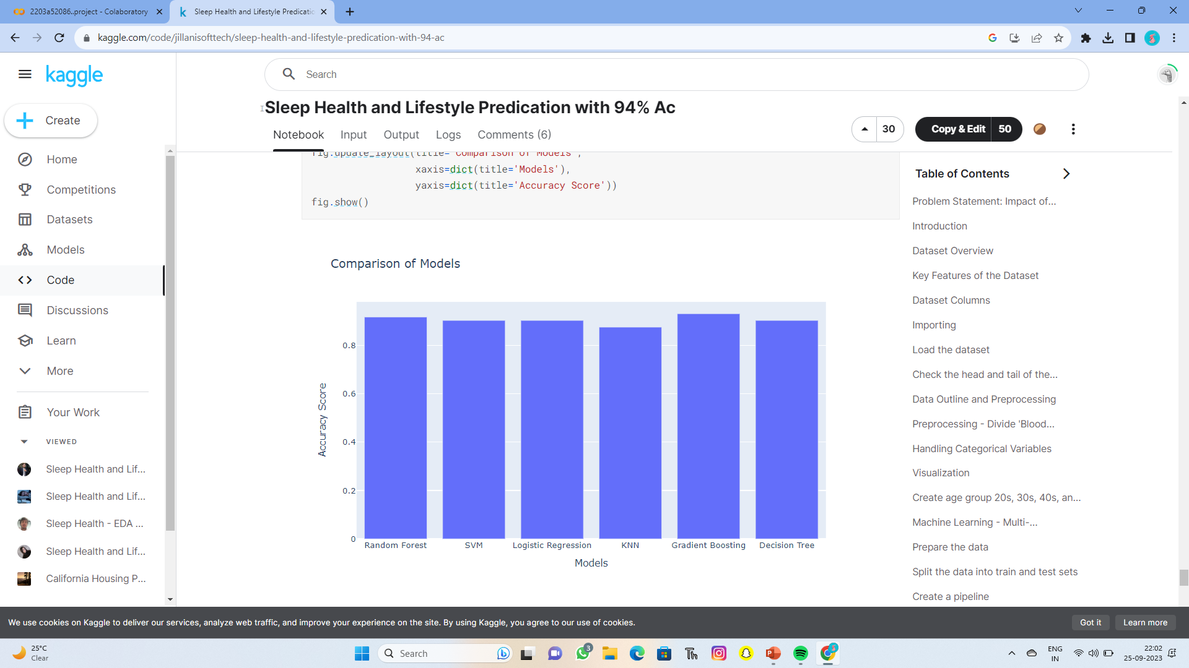
RESULT ANALYSIS : my performance comparision: Kaggle comparison model:

Slide 8
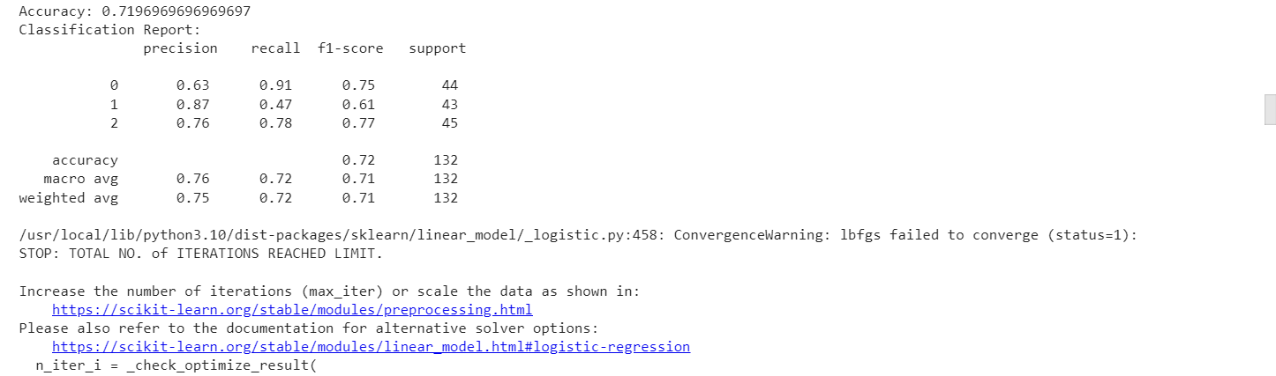
Logistic Regression Logistic regression is a supervised machine learning algorithm mainly used for classification tasks where the goal is to predict the probability that an instance of belonging to a given class. It is used for classification algorithms its name is logistic regression

Slide 9

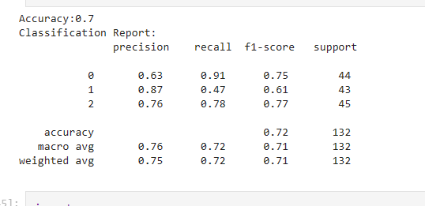
SVM classifier: A support vector machine (SVM) is a type of supervised learning algorithm used in machine learning to solve classification and regression tasks; SVMs are particularly good at solving binary classification problems, which require classifying the elements of a data set into two groups.

Slide 10
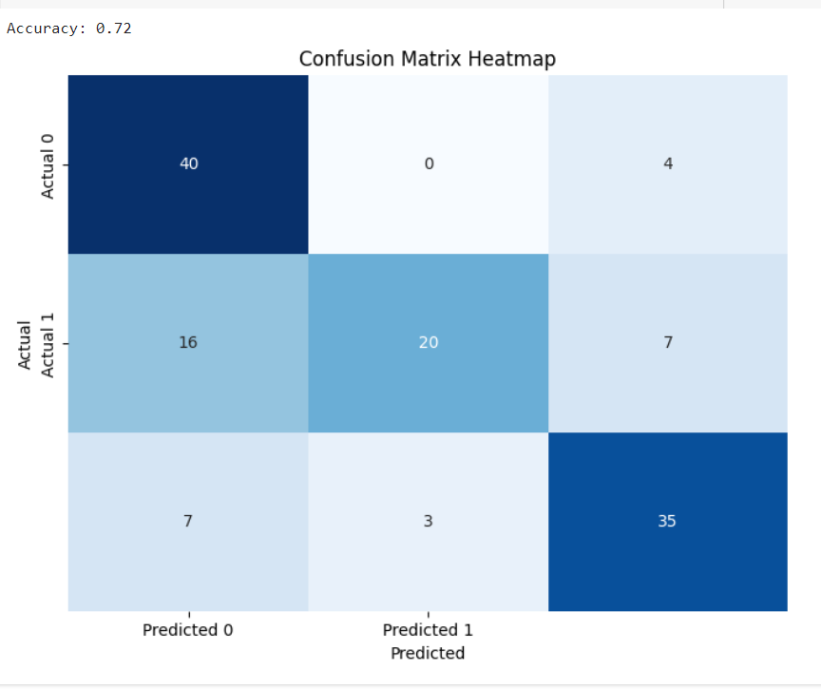
Confusion matrix:

Slide 11

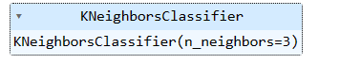
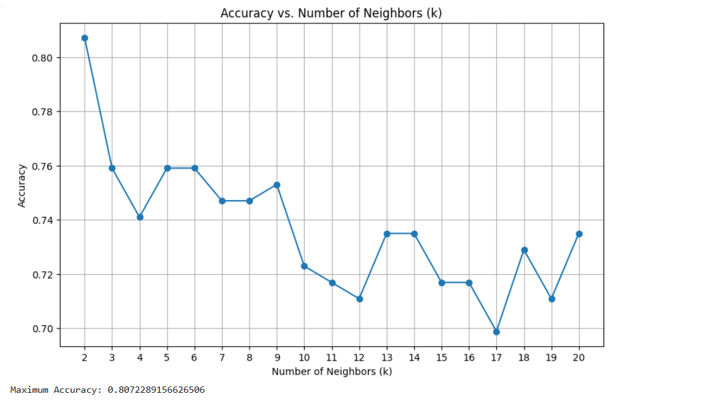
K-NearestNeighbors(KNN): The K-Nearest Neighbor (KNN) algorithm is a popular machine learning technique used for classification and regression tasks. It relies on the idea that similar data points tend to have similarlabels.

Slide 12

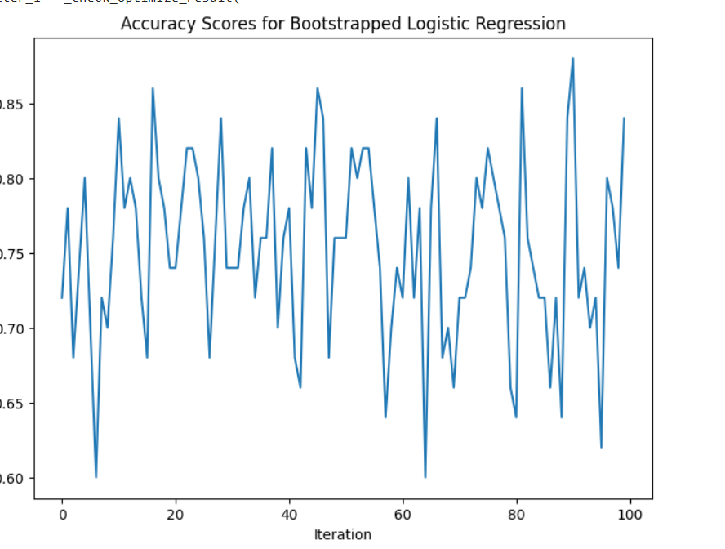
Bootstrapped Logistic Regression: Bootstrapping is rapidly becoming a popular alternative tool to estimate parameters and standard errors for logistic regression model. Bootstrap is a computer intensive method that can be used to estimate variability of estimators, estimate probabilities and quantile related to test statistics or to construct confidence intervals, explore the shape of distribution of estimators

Slide 13
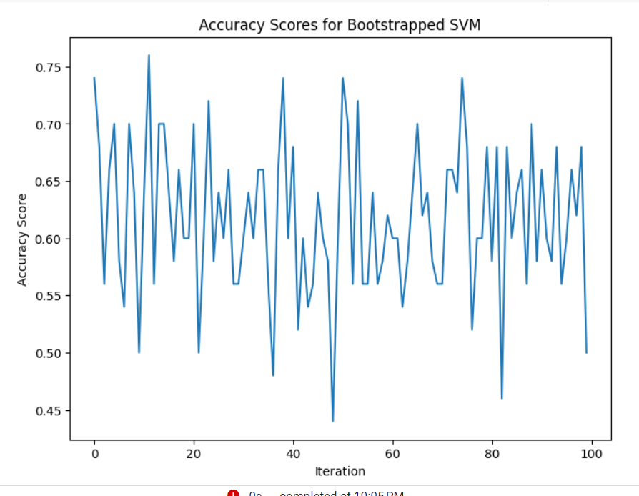
Bootstrapped svm:

Slide 14
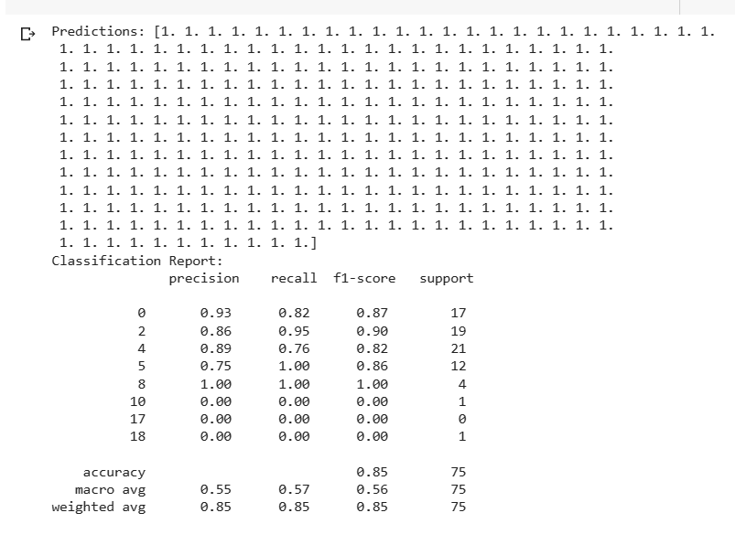
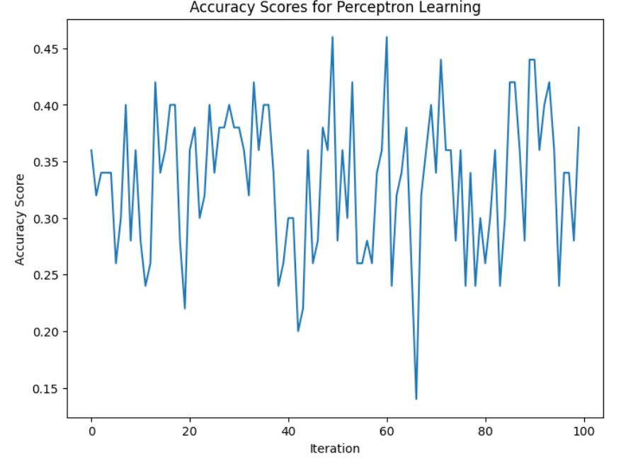
Conclusion: The Sleep Health and Lifestyle Dataset is a comprehensive dataset that provides valuable insights into sleep patterns and daily habits By svm ,logestric regression and K-NearestNeighbors(KNN) Bootstrapped Logistic Regression Bootstrapped svm

Slide 15
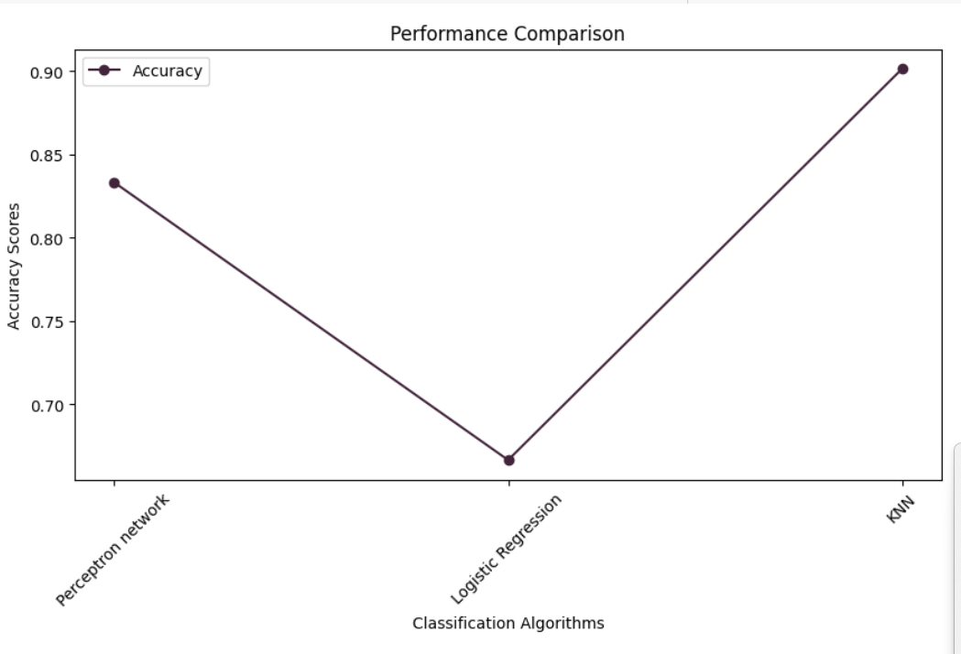
This dataset provides a rich source of information for exploring the impact of various lifestyle factors on sleep health. Analyzing this data can yield valuable insights and assist in developing strategies to improve sleep quality and overall well-being.

Slide 16
Github.link: https://github.com/Saihasini/2203a52086-review2

